Slide 1
Introduction to
The AMOS Project
Dirk Riehle, Univ. Erlangen
AMOS A01
Licensed under CC BY 4.0 International

Slide 2
Course Goals 1 / 2 [1] [2] [3] [4]
To introduce students to agile methods by creating useful open- source software in a team
[1] Professional = ambition + collaboration with external partner
[2] Agile methods = our focus here, specifically Scrum + XP
[3] We teach both overall processes as well as best practices
[4] Useful software is software that has value to someone!

Slide 3
Course Goals 2 / 2
Learning objectives
Gain conceptual understanding and practical skills of using
agile software development methods
software project management tools
software development tools
Learn how to work
with an external stakeholder
in a (student) project team
Project objectives
Develop useful open-source software
Perform a great demo on demo-day!

Slide 4

Industry Partners

Slide 5
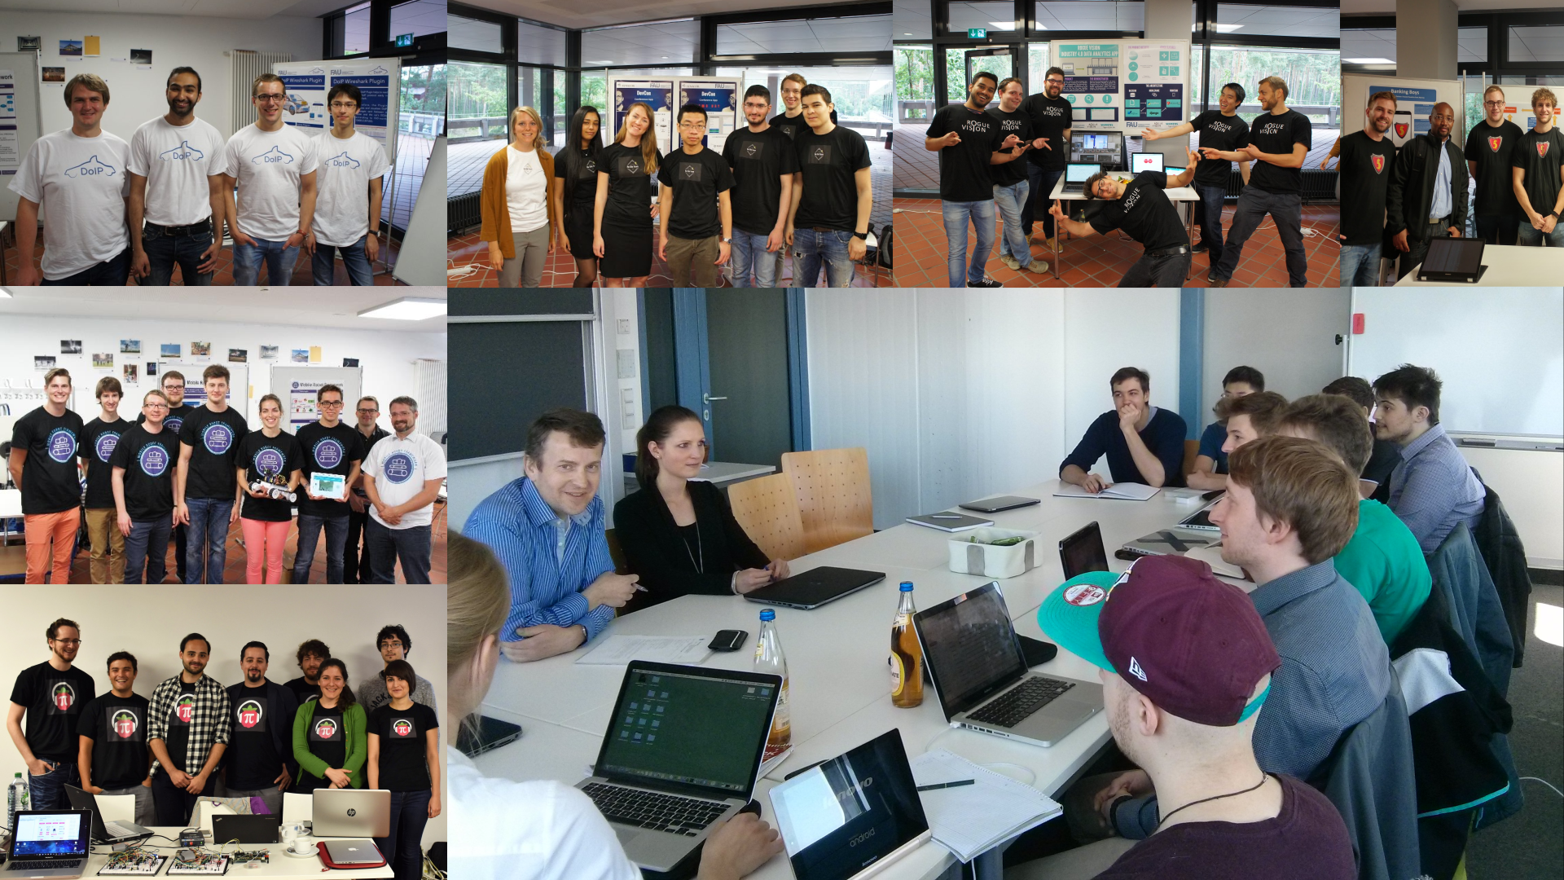

Slide 6
Skills Required for Course
General skills
Willingness and ability to work in a team
Ability to acquire skills during the project
Role-specific skills
Product owner (PO) role
Strong conceptual thinking, ability to communicate well, affinity to technology
Software developer (SD) role
Technology (specific to project), development tools like git, test-driven development
Scrum Master (SM) role
Past successful experience as an AMOS product owner or software developer

Slide 7
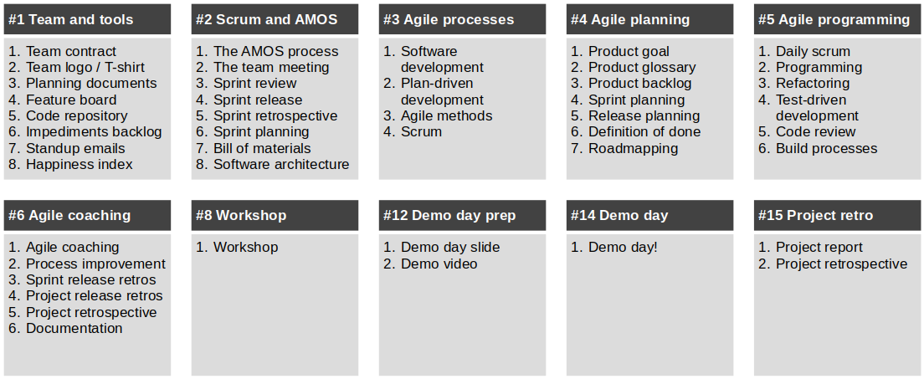
Structure and Content of Course

Slide 8
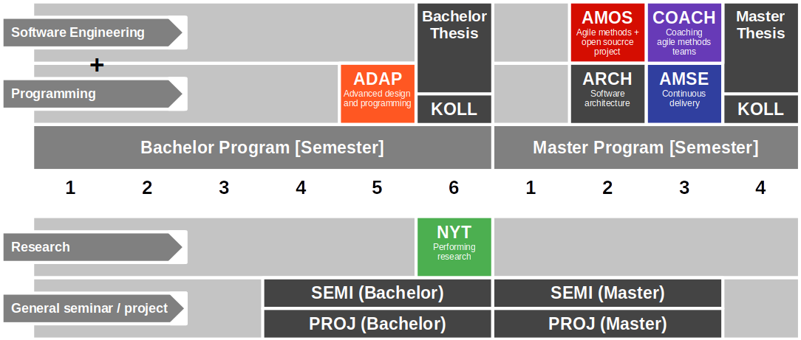
Course Position in Curriculum

Slide 9
Modules and Courses
 |  | Courses (Lehrveranstaltungen)
 |  | AMOS-VL | AMOS-UE (Team Meeting) | COACH-VL | Total ECTS
Modules | AMOS-PO | x | x | – | 5
 | AMOS-SD | x | x | – | 9 / 10
 | AMOS-SM | + | x | x | 3
 | COACH | + | x | x | 5

Slide 10
Availability of Modules
 |  | University
 |  | Univ. Erlangen | TU Berlin | FU Berlin
Modules | AMOS-PO | x | – | –
 | AMOS-SD | x | x | x
 | AMOS-SM | – | x | –
 | COACH | x | – | –

Slide 11
Course Grading [1] by Role (Module)
Product Owner (AMOS-PO)
Theory (lectures) = 20% of grade
2 SWS in 5 ECTS = 20%
As measured by class quizzes
Grading scale is [0..10] points
Practice (project) = 100% of grade
Contribution to teamwork = 50%
As measured in team meetings
Grading scale is [0|1|2|3]
Independent work = 50%
As measured by artifacts
Grading scale is [0|1|2|3]
Software Developer (AMOS-SD)
Theory (lectures) = 10% of grade
2 SWS in 10 ECTS = 10%
As measured by class quizzes
Grading scale is [0..10] points
Practice (project) = 100% of grade
Contribution to teamwork = 50%
As measured in team meetings
Grading scale is [0|1|2|3]
Independent work = 50%
As measured by artifacts
Grading scale is [0|1|2|3]
[1] Also see http://oss.cs.fau.de/teaching/course-resources/grading-schemes-and-scales/

Slide 12
Collaboration and Grading
We are required to grade you individually
If you collaborate, for example,
by pair programming
by pair designing
you agree to be graded jointly

Slide 13
Receiving a Grade for the Course
If you want to receive a grade
You must register through your university’s exam registration system
Your degree program may have split the course into two (VL + UE)
Registration system is different from the course management system
Please check asap that the course is available in your degree program!
In case of problems, please see
https://oss.cs.fau.de/teaching/course-resources/course-registration/
Otherwise: No grade

Slide 14

No Oral or Written Exam [1]
[1] You still have to register for the course

Slide 15
Course Language [1]
Class
Lecturer: English
Student: Choice of German or English
Project
Instructor: English
Team: Choice of German or English
[1] See https://oss.cs.fau.de/2012/03/10/english-or-german-deutsch-oder-englisch/

Slide 16
Course Organization
Course organization
See https://amos.uni1.de
Course schedule
See Schedule tab on Course Organization doc
Project descriptions
See Project Descriptions on Course Organization doc
Project teams
See Project Teams tab on Course Organization doc

Slide 17
Work Rhythm
Lectures
Class day (90min.)
Team meetings
Next slot after lecture
Project work (self-organized)
Deliverables due according to schedule

Slide 18
Course Communication
Announcements are sent by email
Through email aliases
Through course management system
Administrative questions to teaching team
Please ask your question in the course forum
For private questions, use the teaching team email alias
Process questions to your Scrum Master

Slide 19
Thank you! Any questions?
dirk.riehle@fau.de – https://oss.cs.fau.de
dirk@riehle.org – https://dirkriehle.com – @dirkriehle

Slide 20
Legal Notices
License
Licensed under the CC BY 4.0 International license
Copyright
© Copyright 2023 Dirk Riehle, some rights reserved

